Slide 1





KLH University · Sec 10 · Team 4
Interview Practice
Platform
AI Resume Matching & Feedback
Database Systems Engineering and Distributed Backend Development (25CS1302E)
Rasagnya M
Niyathi K
Varshith Comple
2520090018
2520090072
2520080016
Notes:
1

Slide 2

01 · CONTEXT
Problem Statement
Job seekers struggle to find roles that genuinely fit their skills, and even when they land an interview, most prepare with generic questions that don't reflect the role — or get zero feedback on how they actually performed.
The Gap Today
75%+
!
No personalized job matching
Resumes are manually screened or keyword-filtered, missing better-fit roles a candidate never sees.
of resumes are filtered out by ATS or recruiters before a human ever reads them
Few
!
Generic interview prep
One-size-fits-all question banks don't target the specific role's likely questions or a candidate's own gaps.
candidates can access affordable, role-specific interview coaching
Zero
!
No feedback loop
Practicing alone gives no insight into answer quality, pacing, or delivery — the things that actually decide interviews.
structured feedback on delivery when practicing alone at home
Interview Practice Platform
02
Notes:
2

Slide 3
02 · GOALS
Objectives
What this project sets out to achieve, mapped to the problems identified above.
01
02
Accurate resume parsing
Smarter job matching
Extract skills, experience and role signals from a candidate's resume reliably.
Rank job fit using semantic similarity rather than keyword filters alone.
03
04
Role-specific mock interviews
Actionable feedback
Generate interview questions tailored to the matched job and the candidate's gaps.
Score spoken answers on content and delivery so candidates know what to improve.
05
06
Track progress over time
Keep it accessible
Store sessions, transcripts and scores so candidates can see improvement across attempts.
Build entirely on free-tier and open-source infrastructure so it stays affordable.
Interview Practice Platform
03
Notes:
3

Slide 4
05 · APPROACH
Proposed System
An AI-powered platform that matches candidates to roles from their resume, generates role-specific mock interview questions, captures spoken answers in-browser, and returns structured feedback — all running on free-tier and open-source infrastructure.
Resume & Matching Service
Interview & Feedback Engine
• spaCy — resume parsing, skill/experience extraction
• getUserMedia + MediaRecorder — in-browser mic/camera capture
• sentence-transformers — embedding-based job similarity
• faster-whisper — speech-to-text transcription
• Seeded job dataset for match ranking
• Groq/Gemini LLM — question generation & feedback
• REST endpoints consumed by the Node backend
• MongoDB — sessions, transcripts & scores
Interview Practice Platform
06
Notes:
6

Slide 5
06 · DESIGN
System Architecture
Frontend (React)
>
>
>
Design Notes
Resume
Upload
Match
Results
Interview
Q&A
Feedback
Dashboard
• Node and Python are separate services talking over REST — AI logic stays isolated and swappable.
↓ REST calls, auth via Node backend
Backend (Node.js + MongoDB)
• All AI components run on free-tier / open-source tools: Groq, faster-whisper, sentence-transformers.
Auth &
Sessions
<>
MongoDB
Storage
• MongoDB's flexible schema suits variable-length transcripts and evolving question sets.
↓ Orchestrates calls to the AI microservice
AI Service (Python / Flask)
• Stack: React.js, Node.js + Express, Python (Flask), spaCy, sentence-transformers, faster-whisper, Groq/Gemini API, MongoDB Atlas, Git/GitHub.
Resume Parser
& Matching
Question Gen
(Groq/Gemini)
Transcription
(Whisper)
Interview Practice Platform
07
Notes:
7

Slide 6
07 · CAPABILITIES
Modules / Functionalities
01
02
03
Resume Upload & Parsing
Job Matching Engine
AI Question Generation
Extracts skills and experience from resume text using NLP-based parsing.
Scores candidate-job fit using embedding-based similarity against a job dataset.
Generates role-specific mock interview questions from the matched job and resume gaps.
04
05
06
Live Answer Capture
Speech-to-Text & Analysis
AI Feedback & Scoring
In-browser mic and camera recording — no plugins or external apps required.
Transcribes spoken answers and surfaces pacing and filler-word signals.
LLM-based feedback on content and delivery, stored per session for progress tracking.
Interview Practice Platform
08
Notes:
8

Slide 7
08 · FRONTEND
Frontend Design
Key screens in the candidate-facing React application.
Home Page
Login / Registration
Forms
Dashboard
Landing page introducing the platform and entry point to upload a resume.
Candidate authentication — sign up, log in, and session handling.
Resume upload and job-preference forms feeding the matching engine.
Match results, mock interview access and feedback history in one place.
Interview Practice Platform
09
Notes:
9

Slide 8
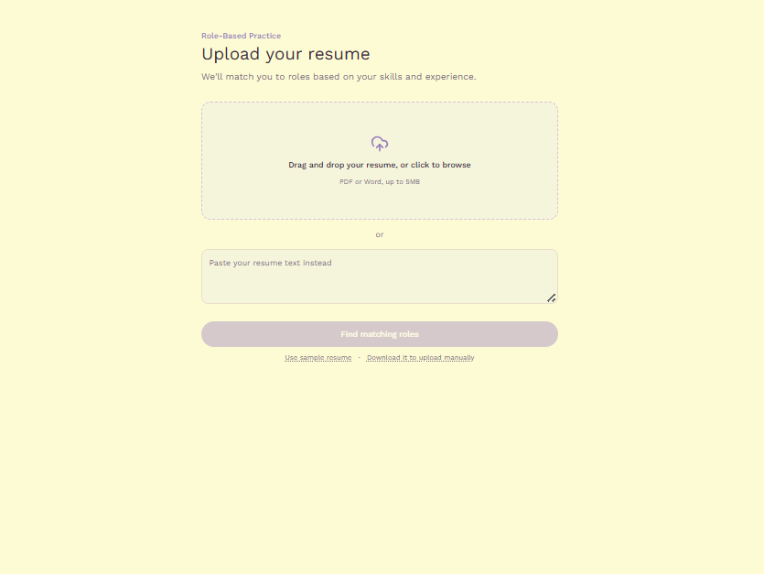
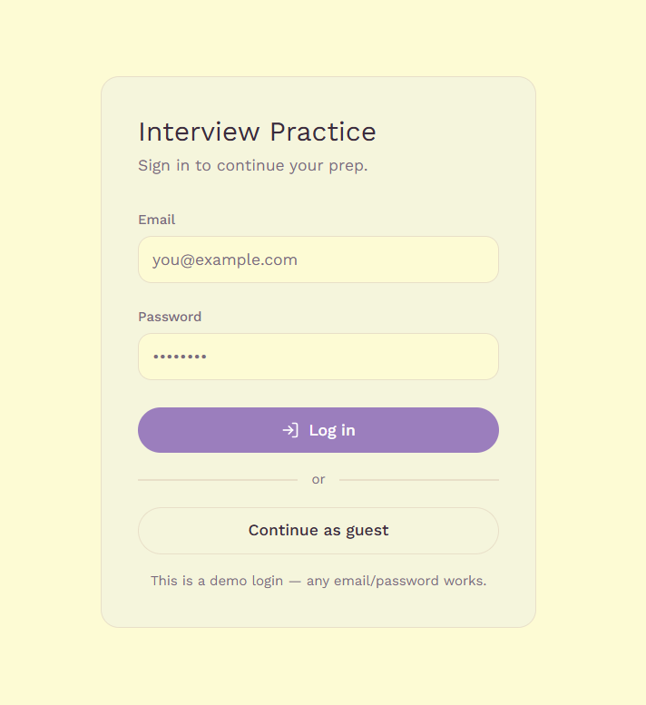
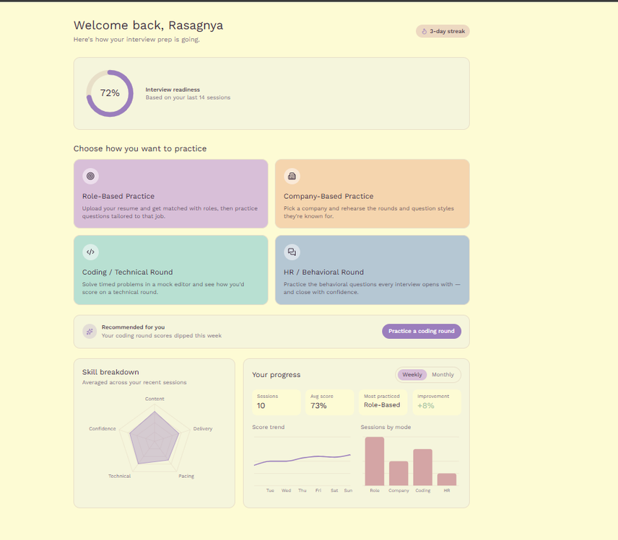
09 · FRONTEND
Frontend Implementation — Screenshots
Interview Practice Platform
10
Notes:
10

Slide 9
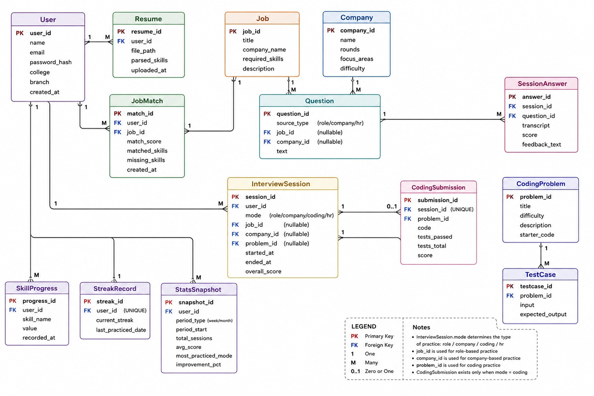
10 · DATABASE
Database Design & ER Diagram
MongoDB collections for candidates, resumes, jobs, sessions and feedback, and how they relate.
[Insert ER Diagram here]
Design Principles
• Flexible, document-based schema to suit variable-length transcripts
• Collections: Users, Resumes, Jobs, InterviewSessions, Feedback
• References between collections via ObjectId rather than deep nesting
• Indexes on candidate ID and session ID for fast dashboard lookups
Interview Practice Platform
11
Notes:
11

Slide 10
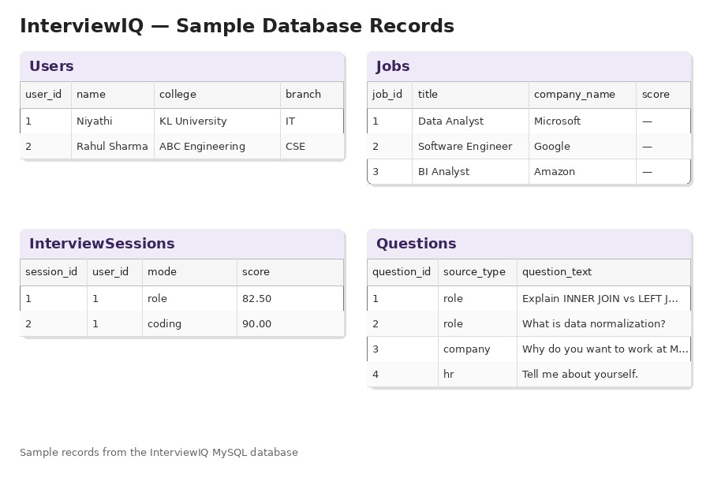
11 · DATABASE
Database Tables / Schema & Sample Records
[Insert sample database
records / table screenshots here]
Schema Overview
Users name, email, passwordHash, createdAt
Resumes userId, parsedSkills[], rawText, uploadedAt
Jobs title, description, requiredSkills[], embedding
InterviewSessions userId, jobId, questions[], transcript, status
Feedback sessionId, contentScore, deliveryScore, comments
Interview Practice Platform
12
Notes:
12

Slide 11
12 · STATUS
Current Progress
Resume parsing service
[In progress]
Job matching engine
[In progress]
Question generation (LLM)
[Not started]
Live answer capture (audio/video)
[Not started]
Speech-to-text pipeline
[Not started]
Feedback dashboard (frontend)
[Not started]
Update the status labels above with the team's actual progress before Review 2.
Interview Practice Platform
13
Notes:
13

Slide 12
13 · STATUS
Challenges / Issues Faced
Open technical questions that come with this three-service, free-tier architecture.
!
Inconsistent resume formats
!
Latency across three services
spaCy-based parsing works well on clean, single-column resumes but accuracy drops on tables, multi-column layouts and graphic-heavy templates — pushing us toward extra pre-processing and fallback rules rather than parsing alone.
A single mock-interview turn chains Node → Flask → an LLM call (and Whisper for transcription). Keeping that feel responsive in a live, in-browser session means careful async handling, not just faster individual calls.
!
Free-tier rate limits
!
Cross-browser audio/video capture
Groq/Gemini and MongoDB Atlas free tiers cap request volume and concurrency, so testing with multiple simultaneous mock sessions needs request queuing and graceful backoff rather than firing calls directly.
getUserMedia and MediaRecorder support different codecs and permission flows across browsers, so a recording flow that works in one browser needs explicit fallback handling to stay consistent in others.
Interview Practice Platform
14
Notes:
14

Slide 13
14 · WHAT'S NEXT
Future Work
Body Language Analysis
Voice Modulation Scoring
MediaPipe-based heuristics for eye contact, posture and fidgeting during mock interviews.
librosa-based pitch, pace and volume analysis for a fuller picture of delivery.
Recruiter Dashboard
Live Job Board Integration
A recruiter-facing view into candidate readiness and match pipelines.
Pull real postings via LinkedIn/Indeed APIs instead of a static seed dataset.
Multi-Language Interviews
Peer Mock Scheduling
Support mock interviews and feedback in regional languages.
Let candidates practice live with peers, with AI scoring both sides.
Interview Practice Platform
15
Notes:
15

Slide 14
03 · LITERATURE
Literature Survey — Resume & Job Matching
Prior work this project builds on for parsing resumes and scoring candidate-job fit.
Wadhwa, Malhotra & Saxena (2020) Automated Resume Screening System using NLP
IJERT, Vol. 9, Issue 5
Early rule- and NLP-based pipeline for screening resumes against job requirements; established the parse-then-score pattern this project follows.
Khatri et al. (2025) AI-Powered Automated Resume Screening and Job Matching System Using NLP and ML
IJRESM, Vol. 8, No. 10
Uses Sentence-BERT to embed resumes and job descriptions and rank fit by cosine similarity — the same embedding-based matching approach used by this platform's sentence-transformers layer.
JobMatchAI (2026) An Intelligent Job Matching Platform Using Knowledge Graphs, Semantic Search & Explainable AI
arXiv preprint
Combines multi-strategy resume parsing (regex + NER) with semantic skill matching, and reports the extraction accuracy trade-offs across name, skills and education fields.
Interview Practice Platform
04
Notes:
4

Slide 15
04 · LITERATURE
Literature Survey — Interview Practice Tools
Existing mock-interview and speech-feedback tools, and the gap between them this project targets.
Existing Tools
The Gap This Project Fills
Google Interview Warmup — Free browser tool that transcribed spoken answers to five questions and showed word-pattern feedback. Retired by Google in April 2026.
• Resume-matching research (previous slide) stops at ranking candidates — it doesn't lead into interview practice.
Pramp / Exponent Practice — Peer-to-peer mock interviews for coding and behavioral rounds — human feedback, not AI-scored, and metered by credits since its 2024 move to Exponent.
• Delivery coaches like Yoodli score speech but ask generic questions, not ones tied to a matched job or the candidate's resume gaps.
Yoodli — AI delivery coach scoring pace, filler words and confidence from speech — strong on delivery, but not tied to a candidate's resume or a specific job.
• Peer platforms like Pramp depend on finding a human partner and don't score content automatically.
OpenAI Whisper (Radford et al., 2022) — Large-scale weakly-supervised speech recognition model — the open-source ASR backbone (via faster-whisper) this project uses for transcription.
• No surveyed tool combines resume-to-job matching, role-specific question generation, and content + delivery scoring in one free-tier pipeline — which is the integration this platform provides.
Interview Practice Platform
05
Notes:
5

Slide 16
15 · CLOSING
Conclusion
• The Interview Practice Platform brings resume-to-job matching and mock-interview feedback into a single workflow — something no single tool surveyed in the literature review does end to end.
• It replaces keyword-filtered resume screening with embedding-based matching (Sentence-BERT-style similarity), so candidates see roles that genuinely fit their skills, not just their keywords.
• It replaces generic question banks and delivery-only coaching with mock interviews generated from the matched job and the candidate's own resume gaps, scored on both content and delivery.
• Every component — spaCy, sentence-transformers, faster-whisper, Groq/Gemini, MongoDB Atlas — runs on free-tier or open-source infrastructure, so the platform stays accessible to the candidates who need it most.
• [Close with the team's specific next milestone toward the final review]
Interview Practice Platform
16
Notes:
16

Slide 17

Thank You
Notes:
17

